Slide 1
Statistics
Dhrub Satyam
(Data Scientist)

Slide 2





















What is Statistics?
Statistics is a mathematical science including methods of collecting, organizing and analyzing data in such a way that meaningful conclusions can be drawn from them. In general, its investigations and analyses fall into two broad categories called descriptive and inferential statistics.

Slide 3

















Slide 4











Developing Statistical Thinking
Statistics include numerical facts and figures. For instance:
• The largest earthquake measured 9.2 on the Richter scale.
• Men are at least 10 times more likely than women to commit murder.
• One in every 8 Americans is COVID positive.
The study of statistics involves math and relies upon calculations of numbers. But it also relies heavily on how the numbers are chosen and how the statistics are interpreted. For example, consider some scenarios and the interpretations based upon the presented statistics.
1. A new advertisement for Amul’s ice cream introduced in late May of last year resulted in a 30% increase in ice cream sales for the following three months. Thus, the advertisement was effective.
2. The more liquor shop in a city, the more crime there is. Thus, liquor shops lead to crime.

Slide 5
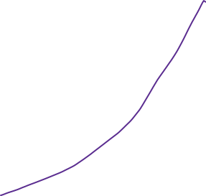


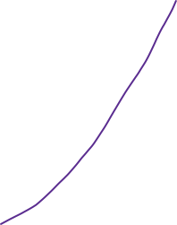






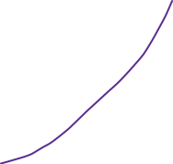








Slide 6

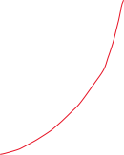





























Slide 7










Slide 8


























Slide 9


















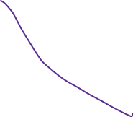












Slide 10





















Slide 11












Slide 12








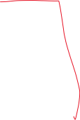









Flaw: A major flaw is that ice cream consumption generally increases in the months of June, July, and August regardless of advertisements. This effect is called a history effect and leads people to interpret outcomes as the result of one variable when another variable (in this case, one having to do with the passage of time) is actually responsible.
Flaw: A major flaw is that both increased liquor shops and increased crime rates can be explained by larger populations. In bigger cities, there are both more liquor shops and more crime. This problem refers to the third-variable problem. Namely, a third variable can cause both situations; however, people erroneously believe that there is a causal relationship between the two primary variables rather than recognize that a third variable can cause both.
Hence, the correct Interpretation of the numbers are necessary!!!!

Slide 13






Types of Statistics:
1. Descriptive statistics deals with the processing of data without attempting to draw any inferences from it. The characteristics of the data are described in simple terms. Events that are dealt with include everyday happenings such as accidents, prices of goods, business, incomes, epidemics, sports data, population data.
2. Inferential statistics is a scientific discipline that uses mathematical tools to make forecasts and projections by analysing the given data. This is of use to people employed in such fields as engineering, economics, biology, the social sciences, business, agriculture and communications.

